Slide 1
CHAPTER 1 INTRODUCTION ON COMPUTER NETWORK
ThS. Nguyễn Viết Hùng
Khoa: Công nghê thông tin
Email: hungnv@eaut.edu.vn
Web: https://nvhung278.blogspot.com/

Slide 2
Chapter 1: ROADMAP
What is Computer Network?
Network edge
end systems, access networks, links
Network core
packet switching, circuit switching, network structure
Delay, loss, throughput in networks
Protocol layers, service models
Networks under attack: security
History

Slide 3
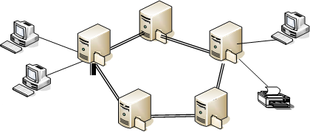
ĐỊNH NGHĨA
Mạng máy tính:
thiết bị mạng (host, server, network devices)
phương tiện truyền dẫn vật lý (transmission medium)
kiến trúc mạng (network architecture)
cấu trúc mạng (Topology)
giao thức mạng (Protocols)

Slide 4





















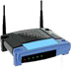


















What’s the Internet: a component view
PC
server
millions of connected computing devices:
hosts = end systems
mobile network
wireless laptop
global ISP
smartphone
running network apps
communication links
fiber, copper, radio, satellite
transmission rate:
bandwidth
Packet switches: forward packets (chunks of data)
routers and switches
home
network
regional ISP
wireless links
wired
links
router
institutional
network

Slide 5
What’s the Internet: a protocol view
Internet: “network of networks”
Interconnected ISPs
protocols control sending, receiving of msgs
e.g., TCP, IP, HTTP, Skype,
802.11
Internet standards
RFC: Request for comments
IETF: Internet Engineering Task
Force
mobile network
global ISP
home
network
regional ISP
institutional
network

Slide 6


















What’s the Internet: a service view
Infrastructure that provides services to applications:
Web, VoIP, email, games, e- commerce, social nets, …
provides programming interface to apps
hooks that allow sending and receiving app programs to “connect” to Internet
provides service options, analogous to postal service
mobile network
global ISP
home
network
regional ISP
institutional
network

Slide 7
What’s the Internet: goal
Chia sẻ tài nguyên dùng chung
Nâng cao độ tin cậy
Môi trường giao tiếp người – máy
Giảm chi phí đầu tư phần cứng
Bảo đảm các tiêu chuẩn thống nhất về tính bảo mật, an toàn dữ liệu

Slide 8
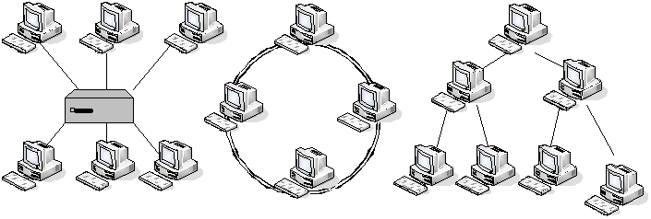
Topology
Kiểu điểm - điểm (Point to Point)
Các mạng có cấu trúc điểm - điểm (Star, Ring, Tree)

Slide 9
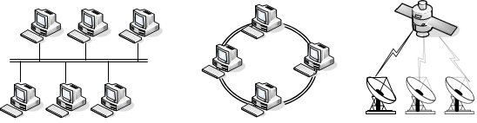
Topology
Kiểu đa điểm hay quảng bá (Point to Multipoint, Broadcasting)
Các mạng có cấu trúc quảng bá (Bus, Ring, and Satellite)

Slide 10
What’s a protocol?
human protocols:
“what’s the time?”
“I have a question”
introductions
… specific msgs sent
… specific actions taken when msgs received, or other events
network protocols:
machines rather than humans
all communication activity in Internet governed by protocols
protocols define format, order of msgs sent and received among network entities, and actions taken on msg
transmission, receipt

Slide 11






What’s a protocol?
a human protocol and a computer network
protocol:
Hi
Hi
TCP connection
request
TCP connection
response
Got the time?
Get http://www.awl.com/kurose-ross
2:00
<file>
time
Q: other human protocols?

Slide 12
What’s a protocol?
Chức năng giao thức
Encapsulation
Fragmentation
Connection control
Monitoring
Flow control
Error control
Synchronization
Addressing

Slide 13
Chapter 1: roadmap
What is the Internet?
Network edge
End systems, access networks, links
Network core
Packet switching, circuit switching, network structure
Delay, loss, throughput in networks
Protocol layers, service models
Networks under attack: security
History

Slide 14


A closer look at network structure
network edge:
hosts: clients and servers
servers often in data centers
mobile network
global ISP
access networks, physical media: wired, wireless communication links
home
network
regional ISP
network core:
interconnected routers
network of networks
institutional
network

Slide 15













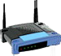





Access networks and physical media
Q: How to connect end systems to edge router?
residential access nets
institutional access networks
(school, company)
mobile access networks
keep in mind:
bandwidth (bits per second) of
access network?
shared or dedicated?

Slide 16









Access net: digital subscriber line (DSL)
central office
telephone network
DSL
modem
splitter
DSLAM
ISP
voice, data transmitted
at different frequencies over dedicated line to central office
DSL access multiplexer
use existing telephone line to central office DSLAM
data over DSL phone line goes to Internet
voice over DSL phone line goes to telephone net
< 2.5 Mbps upstream transmission rate (typically < 1 Mbps)
< 24 Mbps downstream transmission rate (typically < 10 Mbps)

Slide 17
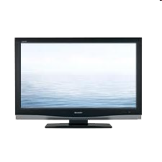








Access net: cable network
cable headend
…
cable
modem
splitter
C O
V V V V V V N
I I I I I I D D T
D D D D D A A R
E E E E E T T O O O O O O O A A L
Shared cable
1 2 3 4 5 6 7 8 9
Channels
frequency division multiplexing: different channels transmitted in different frequency bands

Slide 18
Access net: cable network
cable headend
…
cable splitter modem
cable modem termination system
CMTS
data, TV transmitted at different
frequencies over shared cable
distribution network
ISP
HFC: hybrid fiber coax
asymmetric: up to 30Mbps downstream transmission rate, 2 Mbps upstream transmission rate
network of cable, fiber attaches homes to ISP router
homes share access network to cable headend
unlike DSL, which has dedicated access to central office

Slide 19











Access net: home network
wireless devices
to/from headend or central office
often combined in single box
cable or DSL modem
wireless access
router, firewall, NAT
point (54 Mbps)
wired Ethernet (100 Mbps)

Slide 20






















Enterprise access networks (Ethernet)
link to
ISP (Internet)
router
Ethernet
switch
mail,
web servers
typically used in companies, universities, etc
10 Mbps, 100Mbps, 1Gbps, 10Gbps transmission rates
today, end systems typically connect into Ethernet switch

Slide 21














Wireless access networks
shared wireless access network connects end system to router
via base station aka “access point”
wireless LANs:
within building (100 ft)
802.11b/g (WiFi): 11, 54 Mbps transmission rate
wide-area wireless access
provided by telco (cellular) operator, 10’s km
between 1 and 10 Mbps
3G, 4G: LTE
to Internet
to Internet

Slide 22
Physical media
bit: propagates between transmitter/receiver pairs
physical link: what lies between transmitter & receiver
guided media:
signals propagate in solid media: copper, fiber, coax
unguided media:
signals propagate freely, e.g., radio

Slide 23

Physical media: coax, fiber
twisted pair (TP)
two insulated copper wires
Category 5: 100 Mbps, 1 Gpbs Ethernet
Category 6: 10Gbps
coaxial cable:
two concentric copper conductors
bidirectional
broadband:
multiple channels on cable
HFC

Slide 24
Physical media: coax, fiber
Fiber optic cable:
Glass fiber carrying light pulses, each pulse a bit
High-speed operation:
high-speed point-to-point transmission (e.g., 10’s-100’s Gpbs transmission rate)
Low error rate:
repeaters spaced far apart
immune to electromagnetic noise

Slide 25
Physical media: radio, viba, Infrared
Radio link types:
Terrestrial microwave
e.g. up to 45 Mbps channels
LAN (e.g.,WiFi)
11Mbps, 54 Mbps
Wide-area (e.g., cellular)
3G cellular: ~ few Mbps
Satellite
Kbps to 45Mbps channel (or multiple smaller channels)
270 msec end-end delay
geosynchronous versus low altitude
Signal carried in electromagnetic spectrum
No physical “wire”
Bidirectional
Bropagation environment effects:
Reflection
Obstruction by objects
Interference

Slide 26
Chapter 1: roadmap
What is the Internet?
Network edge
End systems, access networks, links
Network core
packet switching, circuit switching, network structure
delay, loss, throughput in networks
protocol layers, service models
networks under attack: security
history

Slide 27












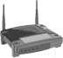












The network core
Mesh of interconnected routers
Packet-switching: hosts break application-layer messages into packets
Forward packets from one router to the next, across links on path from source to destination
Each packet transmitted at full link capacity

Slide 28









Packet-switching: store-and-forward
L bits
per packet
source
3 2 1
destination
one-hop numerical example:
L = 7.5 Mbits
R = 1.5 Mbps
one-hop transmission delay = 5 sec
more on delay shortly …
R bps
takes L/R seconds to transmit (push out) L-bit packet into link at R bps
store and forward: entire packet must arrive at router before it can be transmitted on next link
end-end delay = 2L/R (assuming zero propagation delay)
R bps

Slide 29











Packet Switching: queueing delay, loss
R = 100 Mb/s
C
A
D
R = 1.5 Mb/s
B
queue of packets waiting for output link
E
queuing and loss:
If arrival rate (in bits) to link exceeds transmission rate of link for a period of time:
packets will queue, wait to be transmitted on link
packets can be dropped (lost) if memory (buffer) fills up

Slide 30


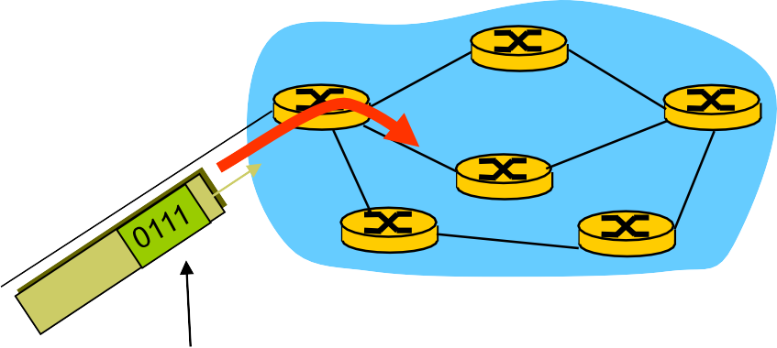




Two key network-core functions
routing: determines source- destination route taken by packets
routing algorithms
forwarding: move packets from router’s input to appropriate router output
routing algorithm
local forwarding table
header value | output link
0100 | 3
0101 | 2
0111 | 2
1001 | 1
1
3
2
dest address in arriving packet’s header

Slide 31











Alternative core: circuit switching
end-end resources allocated to, reserved for “call” between source & dest:
In diagram, each link has four
circuits.
call gets 2nd circuit in top link and 1st circuit in right link.
dedicated resources: no sharing
circuit-like (guaranteed)
performance
circuit segment idle if not used by
call (no sharing)
Commonly used in traditional telephone networks

Slide 32
Circuit switching: FDM versus TDM
Example:
4 users
FDM
frequency
time
TDM
frequency
time

Slide 33
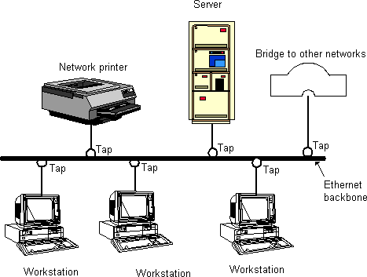
Phân loại mạng máy tính
Theo khoảng cách
□ Mạng cục bộ LAN (Local Area Networks)
Cấu trúc mạng hình BUS

Slide 34
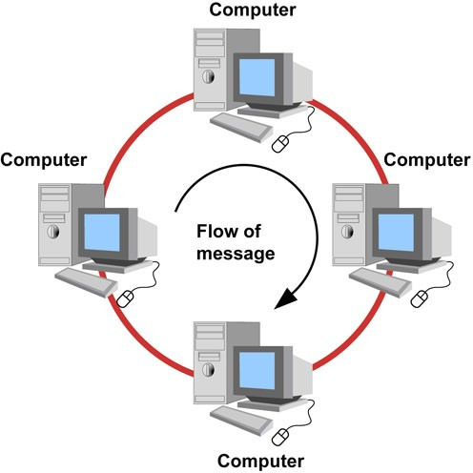
Phân loại mạng máy tính
Theo khoảng cách
Mạng cục bộ LAN (Local Area Networks)
Cấu trúc mạng hình RING

Slide 35
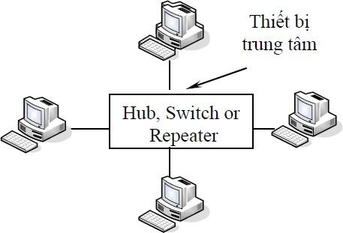
Phân loại mạng máy tính
Theo khoảng cách
Mạng cục bộ LAN (Local Area Networks)
Cấu trúc mạng hình sao

Slide 36
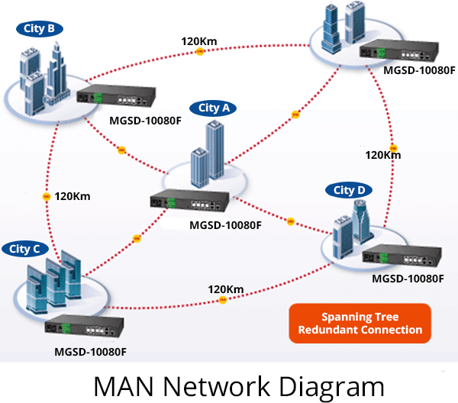
Phân loại mạng máy tính
Theo khoảng cách
Mạng đô thị MAN (Metropolitan Area Networks)

Slide 37
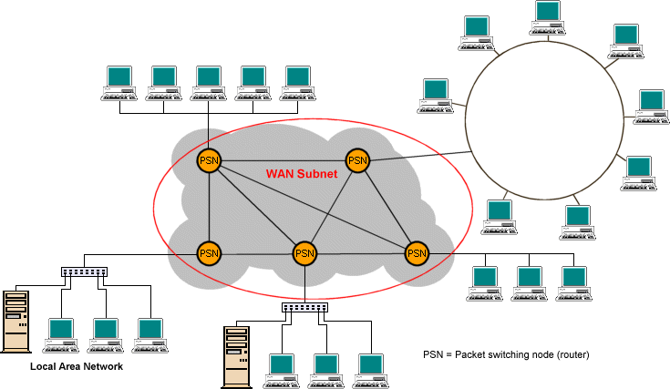
Phân loại mạng máy tính
Theo khoảng cách
Mạng diện rộng WAN (Wide Area Networks)

Slide 38
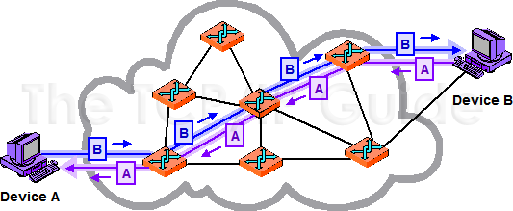
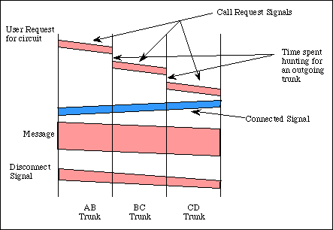
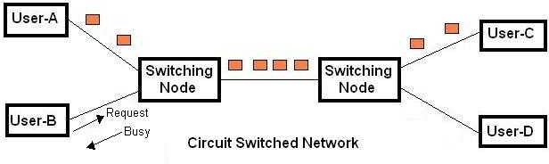
Phân loại mạng máy tính
Phân loại theo cơ chế chuyển mạch
Mạng chuyển mạch kênh (Circuit Switched Networks)

Slide 39
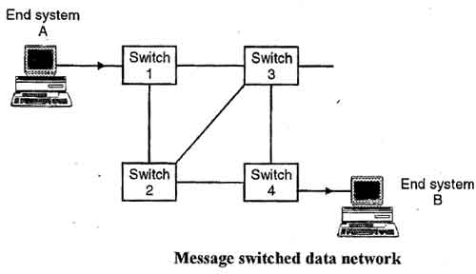
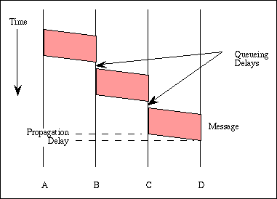
Phân loại mạng máy tính
Phân loại theo cơ chế chuyển mạch
Mạng chuyển mạch thông báo (message-switched network)

Slide 40
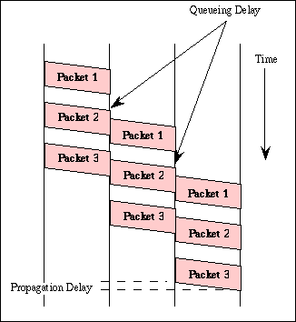
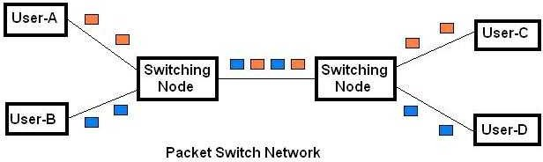
Phân loại mạng máy tính
Phân loại theo cơ chế chuyển mạch
Mạng chuyển mạch gói (Packet Switched Networks)

Slide 41










Phân loại mạng máy tính
Phân loại theo cơ chế chuyển mạch
Mạng chuyển mạch gói (Packet Switched Networks)
A
R1 R2 R3
B
t_{s1}
 | _{t} “Store-and-Forward” at s2
t_{p1} |  | t_{s3}
t_{p2} |  |  | t_{s4}
each Router
min(d_{e2e} ) = ∑ (t _{p} + t )
n
i=1 i
s
i
t_{p3}
t_{p4}
A
R1 R2 R3
B
^{t}s1
^{t}q1
^{t}s2
^{t}q2
e2e ∑
n
^{t}p1
^{t}s3
d =
(t _{p} + t_{s} + t_{q} )
i i i
^{t}p2
i=1
^{t}s4
^{t}p3
Trong điều kiện tải cao, các gói đi vào nút mạng phải đợi trong hàng đợi trước khi được gửi ra đầu ra
^{t}p4
41

Slide 42
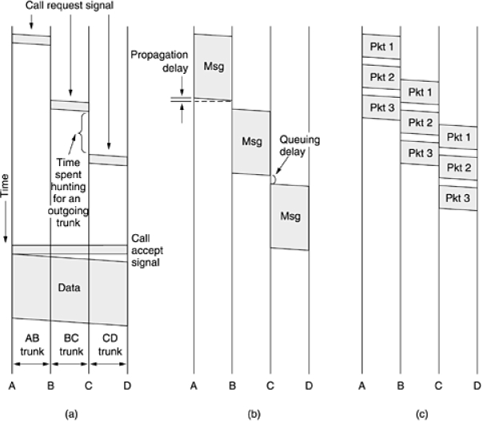
Phân loại mạng máy tính
Phân loại theo cơ chế chuyển mạch
So sánh các cơ chế chuyển mạch (bài tập)

Slide 43
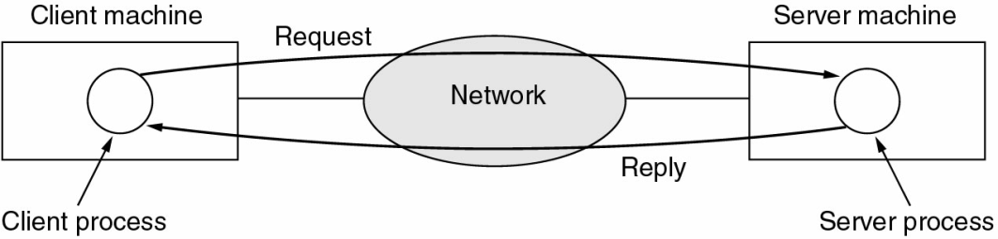
Phân loại mạng máy tính
Phân loại theo mô hình xử lý dữ liệu
Mô hình Client-Server
Mô hình chủ /khách (Client / Server)

Slide 44
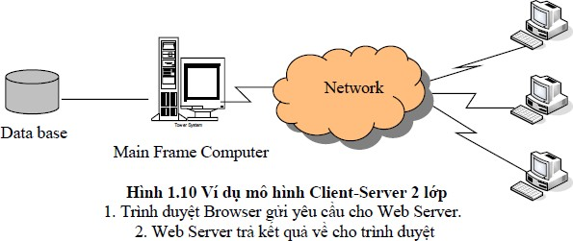
Phân loại mạng máy tính
Phân loại theo mô hình xử lý dữ liệu
Mô hình Client-Server

Slide 45
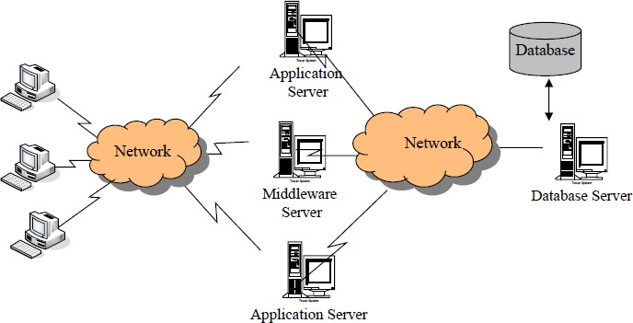
Phân loại mạng máy tính
Phân loại theo mô hình xử lý dữ liệu
Mô hình Client-Server
Mô hình Client-Server nhiều lớp

Slide 46
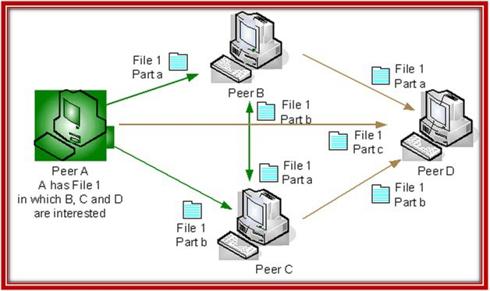
Phân loại mạng máy tính
Phân loại theo mô hình xử lý dữ liệu
Mô hình ngang hàng (Peer-to-Peer)

Slide 47
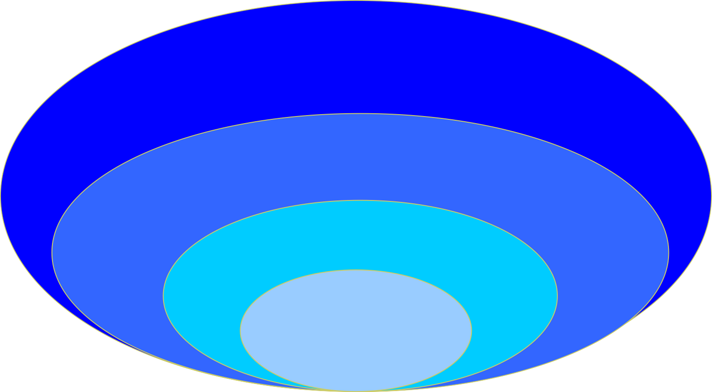
Kích cỡ mạng
WAN
3GPP 3G, LTE
IEEE 802.20
ATM
MAN ETSI HIPERMAN
& HIPER ACCESS
IEEE 802.4,6,16
IEEE
802.3,5,11
LAN ETSI HIPERLAN
PAN (<10m) (IEEE802.15, ETSI HIPER PAN)

Slide 48
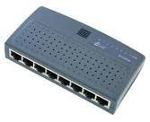
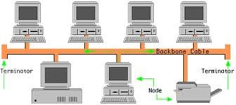

Một số mạng điển hình
IEEE 802
IEEE 802.3: Chuẩn mạng LAN/MAN – Ethernet
IEEE 802.4: Chuẩn mạng LAN – Token Bus, chủ yếu được sử dụng trong công nghiệp)

Slide 49
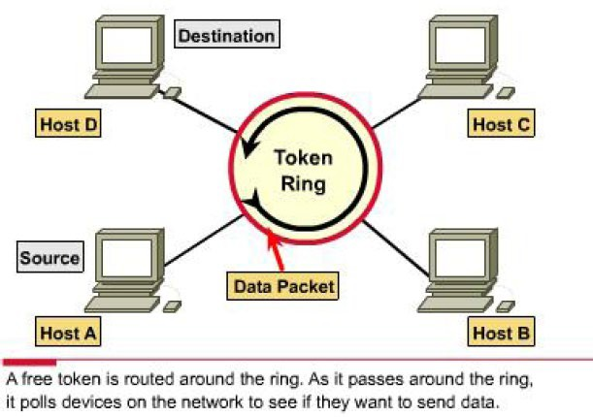
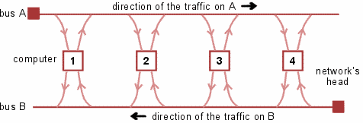
Một số mạng điển hình
IEEE 802
IEEE 802.5: chuẩn mạng LAN – Token Ring được phát triển bởi IBM
IEEE 802.6: chuẩn mạng MAN – DQDB (Distributed Queue Dual Bus) với tốc độ 150Mbit/s trên khoảng cách 160km

Slide 50
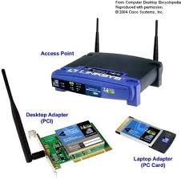
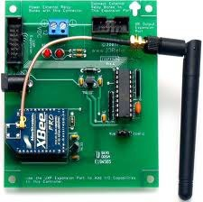

Một số mạng điển hình
IEEE 802
IEEE 802.11: chuẩn mạng LAN không dây
IEEE 802.15: chuẩn mạng cá nhân không dây (Wireless Personal Area
Network - WPAN)
IEEE 802.15.1: BlueTooth
IEEE 802.15.3: High rate WPAN (11 – 55Mbit/s): sử dụng cho các ứng dụng
multimedia
IEEE 802.15.4: Low rate WPAN/ZigBee: cho các ứng dụng tiêu thụ ít năng lượng, tốc độ thấp (Wireless Sensor Network)

Slide 51
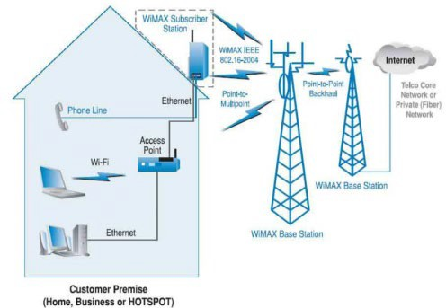
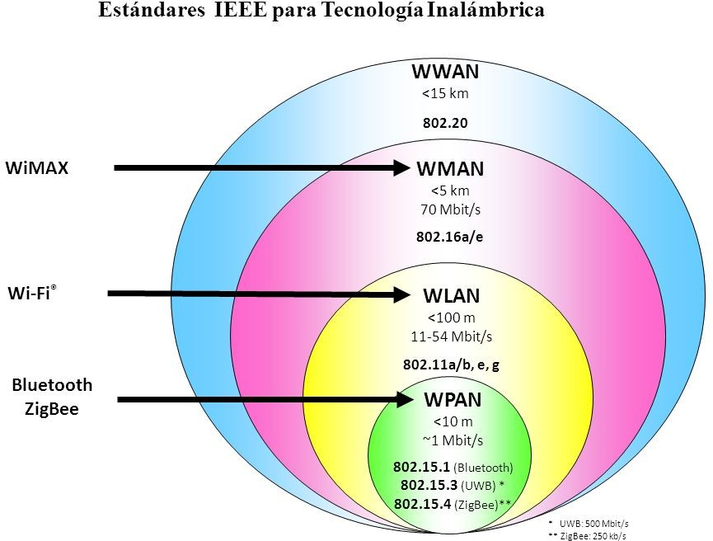
Một số mạng điển hình
IEEE 802
IEEE 802.16: Chuẩn mạng WMAN – WiMAX
IEEE 802.16-2004: WiMAX cố định
IEEE 802.16e-2005: WiMAX di động
IEEE 802.20: WWAN – Mobile Broadband Wireless Access (MBWA), tầm phủ sóng lớn hơn WiMAX (< 15km)

Slide 52


Một số mạng điển hình
3GPP
3G/HSPA (High Speed Packet Access)
LTE (Long Term Evolution)
ATM Forum
ATM

Slide 53
Internet structure: network of networks
End systems connect to Internet via access ISPs (Internet Service Providers)
Residential, company and university ISPs
Access ISPs in turn must be interconnected.
So that any two hosts can send packets to each other
Resulting network of networks is very complex
Evolution was driven by economics and national policies
Let’s take a stepwise approach to describe current Internet structure

Slide 54

Internet structure: network of networks
Question: given millions of access ISPs, how to connect
them together?
access net
access net
access net
access net
access net
access net
access net
access net
access net
access net
access net
access net
access net
access net
access net
access net

Slide 55

Internet structure: network of networks
Option: connect each access ISP to every other access ISP?
access net
access net
access net
access net
access
net
access net
access net
connecting each access ISP to each other directly doesn’t scale: O(N²) connections.
access net
access net
access net
access net
access net
access net
access net
access net
access net

Slide 56








Internet structure: network of networks
Option: connect each access ISP to a global transit ISP? Customer and provider ISPs have economic agreement.
access net
access net
access net
access net
access net
access net
access net
global ISP
access net
access net
access net
access net
access net
access net
access net
access net
access net

Slide 57
Internet structure: network of networks
But if one global ISP is viable business, there will be competitors
….
access net
access net
access net
access net
access net
access net
access net
ISP A
access net
ISP B
access net
ISP C
access net
access net
access
net
access net
access net
access net
access net
57

Slide 58
Internet structure: network of networks
But if one global ISP is viable business, there will be competitors
…. which must be interconnected
Internet exchange point
access net
access net
access net
access net
access net
access net
IXP
access net
ISP A
access net
IXP
access net
ISP B
ISP C
access net
access net
peering link
access
net
access net
access net
access net
access net

Slide 59
Internet structure: network of networks
… and regional networks may arise to connect access nets to ISPS
access net
access net
access net
access net
access net
access net
IXP
access net
ISP A
access net
IXP
access net
ISP B
ISP C
access
net
access net
access net
regional net
access net
access net
access net
access net

Slide 60
Internet structure: network of networks
… and content provider networks (e.g., Google, Microsoft, Akamai ) may run their own network, to bring services, content close to end users
access net
access net
access net
access net
access net
access net
IXP
access net
ISP A
Content provider network
access net
IXP
access net
ISP B
ISP B
access
net
access net
access net
regional net
access net
access net
access net
access net

Slide 61
Internet structure: network of networks
Tier 1 ISP
Tier 1 ISP
Google
IX
IX
IX
P
P
P
Regional ISP
Regional ISP
access
ISP
access
ISP
access
ISP
access
ISP
access
ISP
access
ISP
access
ISP
access
ISP
at center: small # of well-connected large networks
“tier-1” commercial ISPs (e.g., Level 3, Sprint, AT&T, NTT), national &
international coverage
content provider network (e.g, Google): private network that connects it data centers to Internet, often bypassing tier-1, regional ISPs
61

Slide 62
Chapter 1: roadmap
what is the Internet?
network edge
end systems, access networks, links
network core
packet switching, circuit switching, network structure
delay, loss, throughput in networks
protocol layers, service models
networks under attack: security
history

Slide 63




Host: sends packets of data
host sending function:
takes application message
breaks into smaller chunks, known as packets, of length L bits
transmits packet into access network at transmission rate R
link transmission rate, aka link capacity, aka link bandwidth
two packets,
L bits each
2 1
R: link transmission rate
host
packet transmission
delay
time needed to transmit L-bit packet into link
L (bits)
R (bits/sec)
=
=

Slide 64



How do loss and delay occur?
packets queue in router buffers
packet arrival rate to link (temporarily) exceeds output link capacity
packets queue, wait for turn
packet being transmitted (delay)
A
B
packets queueing (delay)
free (available) buffers: arriving packets dropped (loss) if no free buffers

Slide 65
Four sources of packet delay
transmission
A
propagation
B
nodal processing
queueing
^{d}total ^{= d}proc ^{+ d}queue ^{+ d}trans ^{+ d}prop
d_{proc}: nodal processing
d_{queue}: queueing delay
time waiting at output link for transmission
depends on congestion level of router
check bit errors
determine output link
typically < msec

Slide 66
Four sources of packet delay
transmission
A
propagation
B
nodal processing
queueing
^{d}total ^{= d}proc ^{+ d}queue ^{+ d}trans ^{+ d}prop
d_{trans}: transmission delay:
L: packet length (bits)
R: link bandwidth (bps)
d_{prop}: propagation delay:
d: length of physical link
s: propagation speed in medium (~2x10⁸ m/sec)
d_{prop} = d/s
d_{trans} = L/R
^{d}trans ^{and d}prop very different

Slide 67
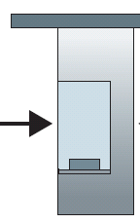



Caravan analogy
100 km
100 km
ten-car caravan
toll
booth
toll
booth
10 cars “propagate” at 100 km/hr
toll booth takes 12 sec to service car (bit transmission time)
car~bit; caravan ~ packet
Q: How long until caravan is lined up before 2nd toll booth?
time to “push” entire caravan through toll booth onto highway = 12*10 = 120 sec
time for last car to propagate from 1st to 2nd toll both: 100km/(100km/hr)= 1 hr
A: 62 minutes

Slide 68



Caravan analogy (more)
100 km
100 km
ten-car caravan
toll
booth
toll
booth
suppose cars now “propagate” at 1000 km/hr
and suppose toll booth now takes one min to service a car
Q: Will cars arrive to 2nd booth before all cars serviced at first booth?
A: Yes! after 7 min, 1st car arrives at second booth; three cars still at 1st booth.

Slide 69
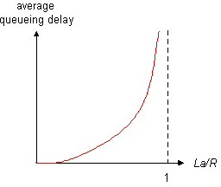

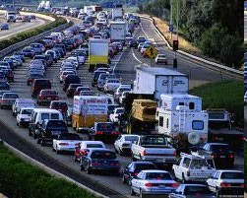
Queueing delay (revisited)
R: link bandwidth (bps)
L: packet length (bits)
a: average packet arrival rate
traffic intensity
= La/R
La/R ~ 0: avg. queueing delay small
La/R -> 1: avg. queueing delay large
La/R > 1: more “work” arriving
than can be serviced, average delay infinite!
La/R ~ 0
La/R -> 1

Slide 70








“Real” Internet delays and routes
what do “real” Internet delay & loss look like?
traceroute program: provides delay measurement from source to router along end-end Internet path towards destination. For all i:
sends three packets that will reach router i on path towards destination
router i will return packets to sender
sender times interval between transmission and reply.
3 probes
3 probes
3 probes

Slide 71
“Real” Internet delays, routes
traceroute: gaia.cs.umass.edu to www.eurecom.fr
3 delay measurements from gaia.cs.umass.edu to cs-gw.cs.umass.edu
1 cs-gw (128.119.240.254) 1 ms 1 ms 2 ms
2 border1-rt-fa5-1-0.gw.umass.edu (128.119.3.145) 1 ms 1 ms 2 ms
cht-vbns.gw.umass.edu (128.119.3.130) 6 ms 5 ms 5 ms
jn1-at1-0-0-19.wor.vbns.net (204.147.132.129) 16 ms 11 ms 13 ms
jn1-so7-0-0-0.wae.vbns.net (204.147.136.136) 21 ms 18 ms 18 ms
abilene-vbns.abilene.ucaid.edu (198.32.11.9) 22 ms 18 ms 22 ms
nycm-wash.abilene.ucaid.edu (198.32.8.46) 22 ms 22 ms 22 ms
62.40.103.253 (62.40.103.253) 104 ms 109 ms 106 ms
de2-1.de1.de.geant.net (62.40.96.129) 109 ms 102 ms 104 ms
10 de.fr1.fr.geant.net (62.40.96.50) 113 ms 121 ms 114 ms
11 renater-gw.fr1.fr.geant.net (62.40.103.54) 112 ms 114 ms 112 ms
12 nio-n2.cssi.renater.fr (193.51.206.13) 111 ms 114 ms 116 ms
13 nice.cssi.renater.fr (195.220.98.102) 123 ms 125 ms 124 ms
trans-oceanic link
14 r3t2-nice.cssi.renater.fr (195.220.98.110) 126 ms 126 ms 124 ms
15 eurecom-valbonne.r3t2.ft.net (193.48.50.54) 135 ms 128 ms 133 ms
16 194.214.211.25 (194.214.211.25) 126 ms 128 ms 126 ms
17 * * *
18 * * *
* means no response (probe lost, router not replying)
19 fantasia.eurecom.fr (193.55.113.142) 132 ms 128 ms 136 ms

Slide 72

Packet loss
queue (aka buffer) preceding link in buffer has finite capacity
packet arriving to full queue dropped (aka lost)
lost packet may be retransmitted by previous node, by source end system, or not at all
buffer (waiting area)
A
packet being transmitted
B
packet arriving to
full buffer is lost

Slide 73








Throughput
throughput: rate (bits/time unit) at which bits transferred between sender/receiver
instantaneous: rate at given point in time
average: rate over longer period of time
server, with file of F bits
to send to client
link capacity R_{s} bits/sec
link capacity R_{c} bits/sec
server sends bits (fluid) into pipe
pipe that can carry fluid at rate
R_{s} bits/sec)
pipe that can carry fluid at rate
R_{c} bits/sec)

Slide 74
















Throughput (more)
R_{s} < R_{c}
What is average end-end throughput?
R_{s} bits/sec
R_{c} bits/sec
R_{s} > R_{c}
What is average end-end throughput?
R_{s} bits/sec
R_{c} bits/sec
bottleneck link
link on end-end path that constrains end-end throughput

Slide 75













Throughput: Internet scenario
per-connection end-end throughput: min(R_{c},R_{s},R/10)
in practice: R_{c} or
R_{s}
R_{s}
R_{s}
R
R
c
R
c
R is often
s
bottleneck
R_{c}
10 connections (fairly) share backbone bottleneck link R bits/sec

Slide 76
Chapter 1: roadmap
what is the Internet?
network edge
end systems, access networks, links
network core
packet switching, circuit switching, network structure
delay, loss, throughput in networks
protocol layers, service models
networks under attack: security
history

Slide 77
Protocol “layers”
Networks are complex,
with many “pieces”:
hosts
routers
links of various media
applications
protocols
hardware, software
Question:
is there any hope of organizing structure of network?

Slide 78
Organization of air travel
ticket (purchase)
ticket (complain)
baggage (check)
baggage (claim)
gates (load)
gates (unload)
runway takeoff
runway landing
airplane routing
airplane routing
airplane routing
a series of steps

Slide 79

Layering of airline functionality
ticket (purchase)
ticket (complain)
ticket
baggage (check)
baggage (claim
baggage
gates (load)
gates (unload)
gate
runway (takeoff)
runway (land)
takeoff/landing
airplane routing
airplane routing airplane routing
intermediate air-traffic control centers
airplane routing
airplane routing
departure airport
arrival airport
layers: each layer implements a service
via its own internal-layer actions
relying on services provided by layer below

Slide 80
Why layering?
Dealing with complex systems:
explicit structure allows identification, relationship of complex system’s pieces
layered reference model for discussion
modularization eases maintenance, updating of
system
change of implementation of layer’s service transparent to rest of system
e.g., change in gate procedure doesn’t affect rest of system
layering considered harmful?

Slide 81
OSI Model
ISO (International standard Organization) tổ chức tiêu chuẩn hóa Quốc tế đề xuất mô hình tham chiếu cho việc kết nối các hệ thống mở (Open System Interconnection -OSI model) (It was first introduced in the late 1970s).
An open system is a model that allows any two different systems to communicate regardless of their underlying architecture (hardware or software).
The OSI model is not a protocol; it is model for understanding and designing a network architecture that is flexible, robust and interoperable.

Slide 82
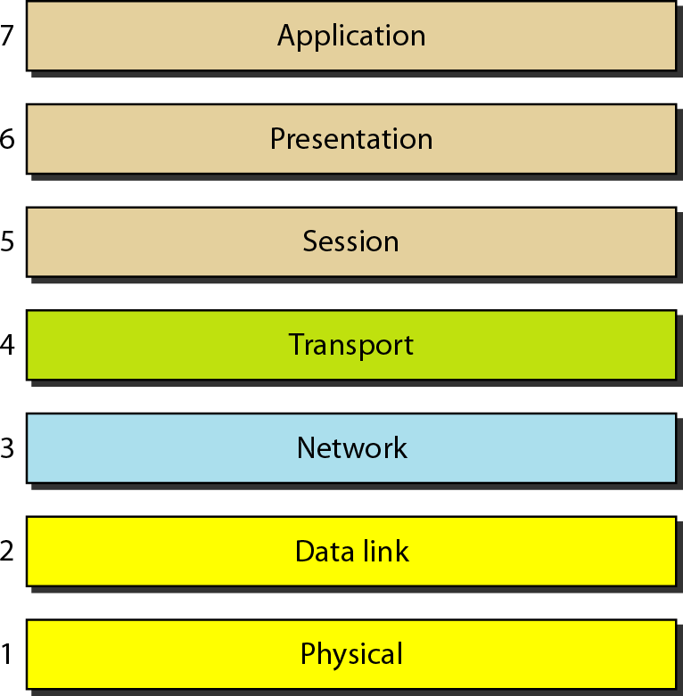
OSI Model
The OSI model is a layered framework for the design of network systems that allows for communication across all types of computer systems.
The OSI model is built of seven ordered layers:
(layer 1) physical layer
(layer 2) data link
(layer 3) network layer
(layer 4) transport layer
(layer 5) session layer
(layer 6) presentation layer
(layer 7) application layer

Slide 83
OSI Model
Layer x on one machine communicates with layer x on
another machine - called Peer-to-Peer Processes.
Interfaces between Layers
Each interface defines what information and services a layer must provide for the layer above it
Organizations of the layers
Network support layers : Layers 1, 2, 3
User support layer : Layer 5, 6, 7
It allows interoperability among unrelated software systems
Transport layer (Layer 4) : links the two subgroups

Slide 84
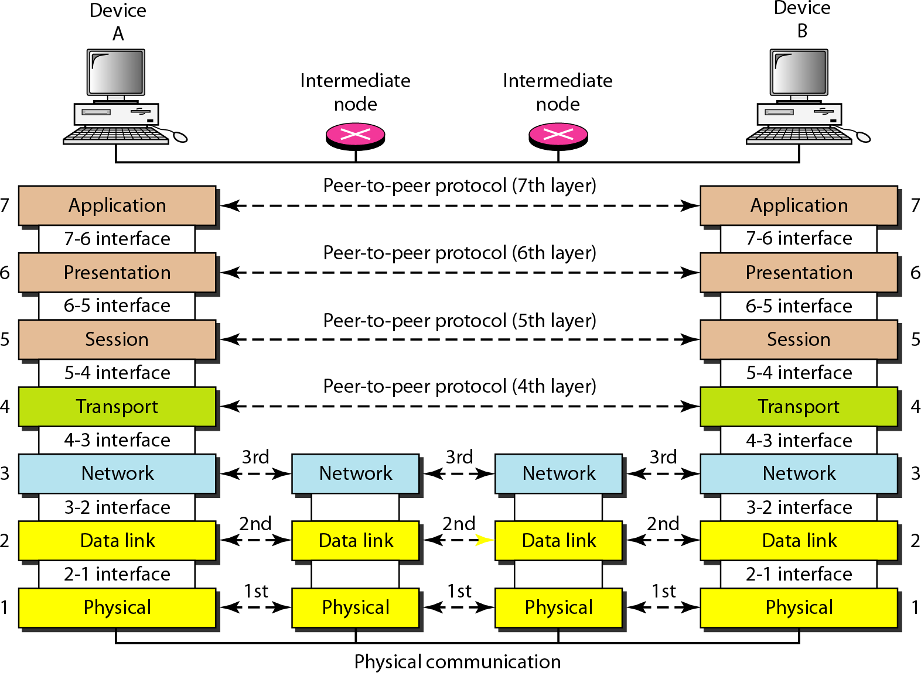
OSI Model

Slide 85
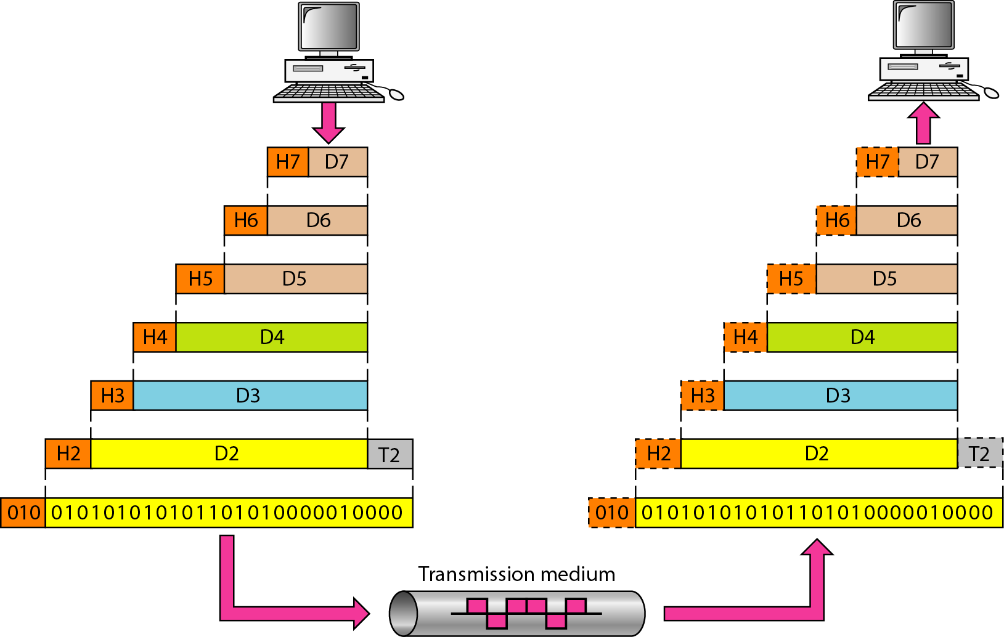
OSI Model
The data portion of a packet at level N-1 carries the whole packet from level N. – The concept is called encapsulation.

Slide 86
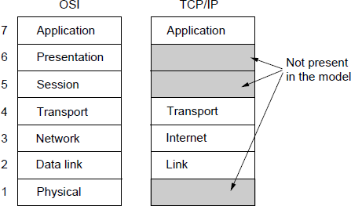
Internet Model (TCP/IP)

Slide 87
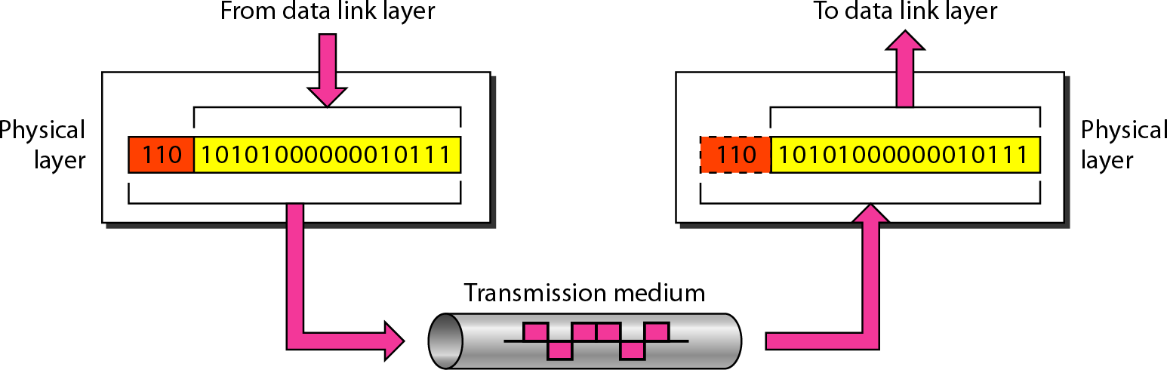
Physical Layer
The physical layer coordinates the functions required to transmit a bit stream over a physical medium. It also defines the procedures and functions that physical devices and interfaces have to perform for transmission occur.
The physical layer is responsible for transmitting individual bits from one node to the next.

Slide 88
Physical Layer
The physical layer is concerned with the following:
Physical characteristics of interfaces and media: The physical layer defines the characteristics of the interface between devices and the transmission media, including its type.
Representation of the bits: the physical layer data consist of a stream of bits without any interpretation. To be transmitted, bits must be encoded into signals – electrical or optical-. The physical layer defines the type of encoding.
Data rate: The physical layer defines the transmission rate, the number of bits sent each second.
Line configuration: the physical layer is concerned with the connection of devices to the medium.
Physical topology
Transmission Mode

Slide 89
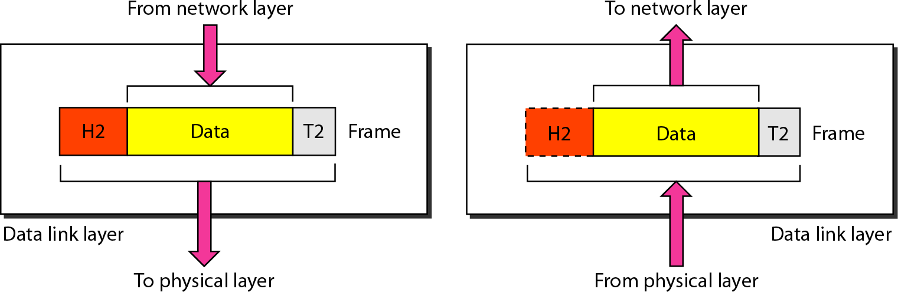
Data Link Layer
The data link layer transforms the physical layer, a raw transmission facility, to a reliable link and is responsible for node- to-node delivery. It makes the physical layer appear error free to the upper layer (network layer).
The data link layer is responsible for transmitting frames from one hop (node) to the next.

Slide 90
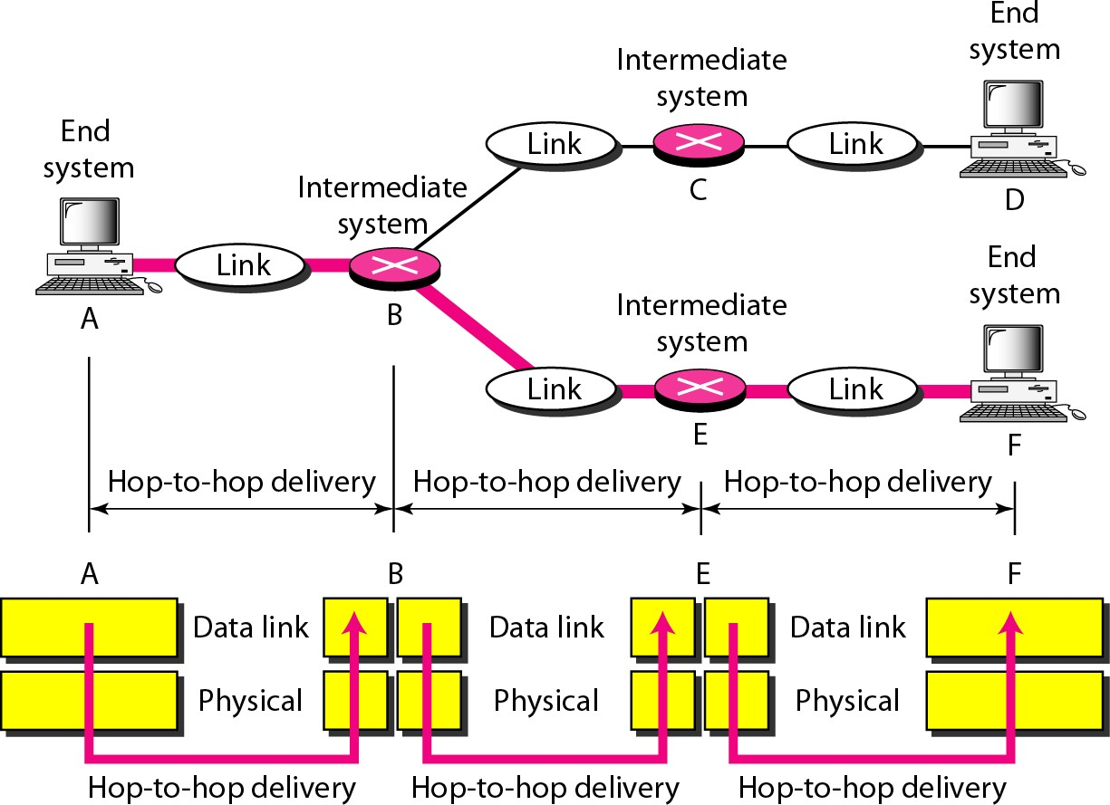
Data Link Layer
Hop-to-hop (node-to-node) delivery

Slide 91
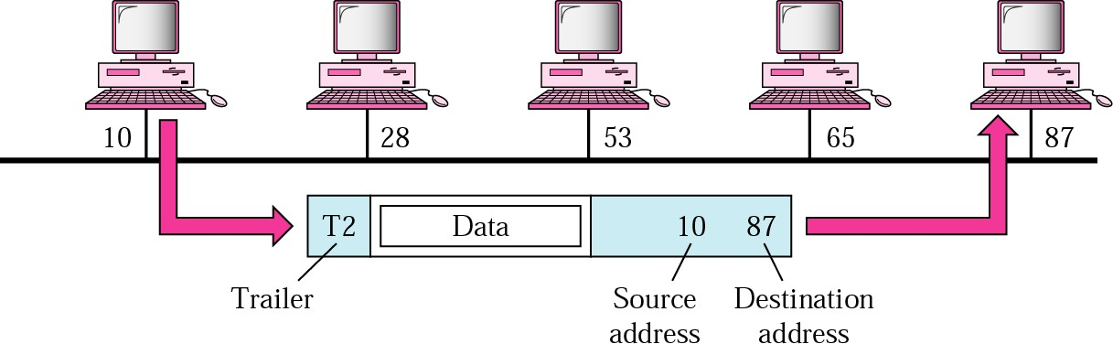
Data Link Layer
Functions of the data link layer:
Framing. The data link layer divides the stream of bits received from the network layer into data units called frames.
Physical addressing. If frames are to be distributed to different systems on the network, the data link layer adds a header to the frame to define the physical address of the sender (source address) and/or receiver (destination address) of the frame.
If the frame is intended for a system outside the sender’s network, the receiver address is the address of the device that connects one network to the next.

Slide 92
Data Link Layer
Flow Control. If the rate at which the data are absorbed by the receiver is less than the rate produced in the sender, the data link layer imposes a flow control mechanism to prevent overwhelming the receiver.
Error control. The data link layer adds reliability to the physical layer by adding mechanisms to detect and retransmit damaged or lost frames. Error control is normally achieved through a trailer to the end of the frame.
Access Control. When two or more devices are connected to the same link, data link layer protocols are necessary to determine which device has control over the link at any time.

Slide 93
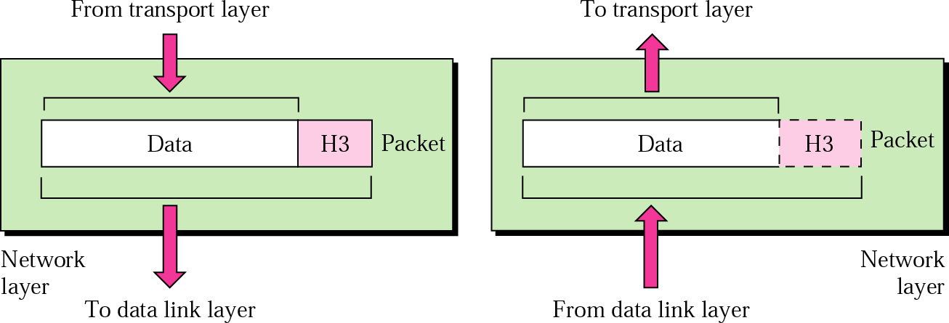
Network Layer
The Network layer is responsible for the source-to-destination delivery of a packet possible across multiple networks.
If two systems are connected to the same link, there is usually no need for a network layer. However, if the two systems are attached to different networks, there is often a need for the network layer to accomplish source-to-destination delivery.

Slide 94
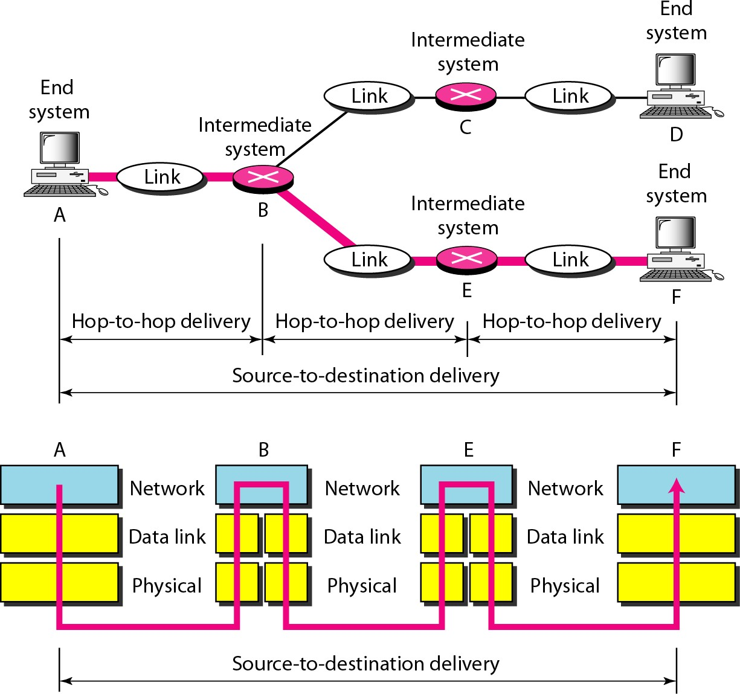
Network Layer
Source-to-destination delivery: The network layer is responsible for the delivery of packets from the original source to the final destination.

Slide 95
Network Layer
Functions of the Network Layer
Logical addressing. The physical addressing implemented by the data link layer handles the addressing problem locally.
The network layer adds a header to the packet coming from the upper layer, among other things, includes the logical address of the sender and receiver.
Routing: When independent networks or links are connected together to create an internetwork (a network of networks) or a large network, the connecting devices (called routers or gateways) route or switch the packets to their final destination.

Slide 96
Transport Layer
The transport layer is responsible for process-to- process delivery of the entire message.
The network layer oversees host-to-destination delivery of individual packets, it does not recognize any relationship between those packets.
The transport layer ensures that the whole message arrives intact and in order, overseeing both error control and flow control at the process-to-process level.

Slide 97
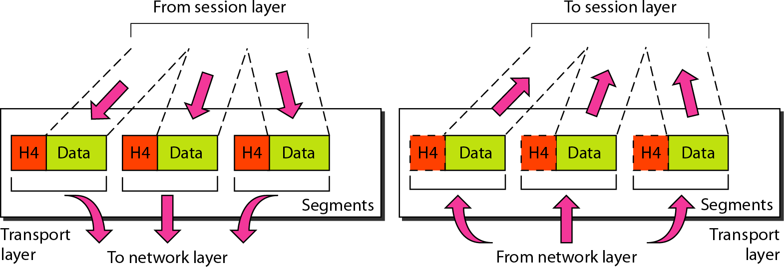
Transport Layer
The transport layer is responsible for delivery of a message from one process to another.

Slide 98
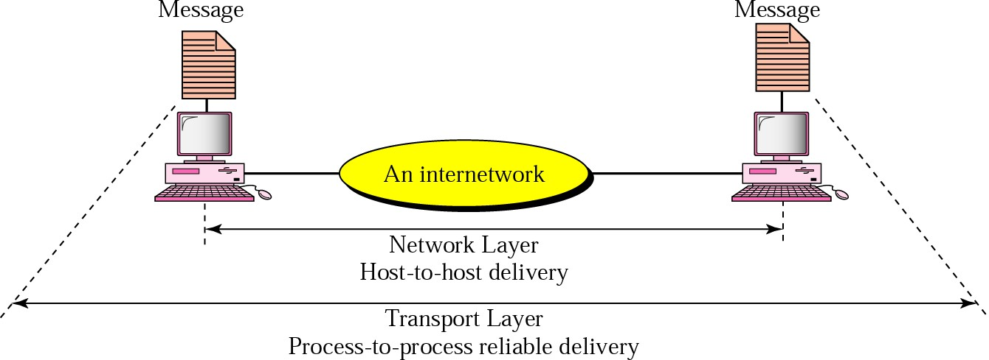
Transport Layer
Functions of the transport layer
Port addressing: computer often run several processes (running programs) at the same time. Process-to-process delivery means delivery from a specific process on one computer to a specific process on the other.
The transport layer header include a type of address called port address.
The network layer gets each packet to the correct computer; the transport
layer gets the entire message to the correct process on that computer.

Slide 99
Transport Layer
Functions of the transport layer
Segmentation and reassembly: a message is divided into transmittable segments, each having a sequence number. These numbers enable the transport layer to reassemble the message correctly upon arrival at the destination.
Connection control: The transport layer can be either
connectionless or connection-oriented.
A connectionless transport layer treats each segment as an independent packet and delivers it to the transport layer at the destination machine.
A connection-oriented transport layer makes a connection with the transport layer at the destination machine first before delivering the packets. After all the data are transferred, the connection is terminated.

Slide 100
Transport Layer
Functions of the transport layer
Flow control: the transport layer performs a flow control end to end. The data link layer performs flow control across a single link.
Error control: the transport layer performs error control end to end. The data link layer performs control across a single link.

Slide 101
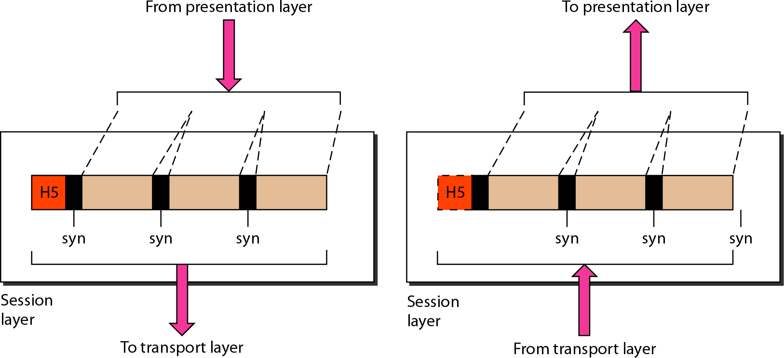
Session Layer
The session layer is the network dialog controller. It was designed to establish, maintain, and synchronize the interaction between communicating devices.

Slide 102

Presentation Layer
The presentation layer was designed to handle the syntax and semantics of the information exchanged between the two systems. It was designed for data translation, encryption, decryption, and compression.

Slide 103

Application Layer
The application layer enables the user to access the network. It provides user interfaces and support for services such electronic email, remote file access, WWW, and so on.

Slide 104
Internet protocol stack
application: supporting network applications
FTP, SMTP, HTTP
transport: process-process data transfer
TCP, UDP
network: routing of datagrams from source to destination
IP, routing protocols
link: data transfer between neighboring network elements
Ethernet, 802.11 (WiFi), PPP
physical: bits “on the wire”
application
transport
network
link
physical

Slide 105
ISO/OSI reference model
presentation: allow applications to interpret meaning of data, e.g., encryption, compression, machine- specific conventions
session: synchronization, checkpointing, recovery of data exchange
Internet stack “missing” these layers!
these services, if needed, must be
implemented in application
needed?
application
presentation
session
transport
network
link
physical

Slide 106








Encapsulation
source
message
M
application
segment
H_{t}
M
transport
H_{t}
datagram
 | H_{n} | H_{t} | M
H_{l} | H_{n} | H_{t} | M
network
H_{n}
frame
link
physical
link
physical
switch
destination
 | H_{n} | H_{t} | M
H_{l} | H_{n} | H_{t} | M
network
M
application
link
H_{n}
H_{t}
M
 |  | H_{t} | M
 | H_{n} | H_{t} | M
H_{l} | H_{n} | H_{t} | M
transport
physical
network
link
router
physical

Slide 107

Summary of Layer’s Duties

Slide 108

IEEE 802

Slide 109
Chapter 1: roadmap
what is the Internet?
network edge
end systems, access networks, links
network core
packet switching, circuit switching, network structure
delay, loss, throughput in networks
protocol layers, service models
networks under attack: security
history

Slide 110
Network security
field of network security:
how bad guys can attack computer networks
how we can defend networks against attacks
how to design architectures that are immune to attacks
Internet not originally designed with (much)
security in mind
original vision: “a group of mutually trusting users attached to a transparent network” ☺
Internet protocol designers playing “catch-up”
security considerations in all layers!

Slide 111
Bad guys: put malware into hosts via Internet
malware can get in host from:
virus: self-replicating infection by receiving/executing object (e.g., e-mail attachment)
worm: self-replicating infection by passively receiving object that gets itself executed
spyware malware can record keystrokes, web sites visited, upload info to collection site
infected host can be enrolled in botnet, used for spam. DDoS attacks

Slide 112






















Bad guys: attack server, network infrastructure
Denial of Service (DoS): attackers make resources (server, bandwidth) unavailable to legitimate traffic by overwhelming resource with bogus traffic
select target
break into hosts around the network (see botnet)
send packets to target from compromised hosts
target

Slide 113






Bad guys can sniff packets
packet “sniffing”:
broadcast media (shared ethernet, wireless)
promiscuous network interface reads/records all packets (e.g., including passwords!) passing by
A
C
src:B dest:A
payload
B
wireshark software used for packet-sniffer

Slide 114






Bad guys can use fake addresses
IP spoofing: send packet with false source address
A
C
src:B
dest:A
payload
B

Slide 115
Chapter 1: roadmap
what is the Internet?
network edge
end systems, access networks, links
network core
packet switching, circuit switching, network structure
delay, loss, throughput in networks
protocol layers, service models
networks under attack: security
history

Slide 116

Internet history
Bắt đầu từ một thí nghiệm của dự án của ARPA
Một liên kết giữa hai nút mạng (IMP tại UCLA và IMP tại SRI).
□ | ARPA: | Advanced Research Project Agency
□ | UCLA: | University California Los Angeles
□ | SRI: | Stanford Research Institute
□ | IMP: | Interface Message Processor

Slide 117


Internet history
3 tháng sau: một mạng hoàn chỉnh với 4 nút, 56kbps
SRI
UTAH
UCSB _{UCLA}

Slide 118

Internet history
ARPANET thời kỳ đầu, 1971: tốc độ phát triển 1 nút/tháng

Slide 119

Internet history
Sự mở rộng của ARPANET, 1974: vượt quá 3.000.000 gói tin/ngày

Slide 120
Internet history
Thập niên 1970:
Từ đầu 1970 xuất hiện các mạng riêng:
ALOHAnet tại Hawaii
DECnet, IBM SNA, XNA
1974: Cerf & Kahn – nguyên lý kết nối các hệ thống mở (Turing Awards)
1976: Ethernet, Xerox PARC

Slide 121

Internet history
1981: Xây dựng mạng NSFNET
NSF: National Science Foundation: Phục vụ cho nghiên cứu khoa học, do sự quá tải của ARPANET

Slide 122

Internet history
1986: Nối kết USENET& NSFNET

Slide 123
Internet history
Thêm nhiều mạng mới nối vào: MFENET, HEPNET (Dept. Energy), SPAN (NASA), BITnet, CSnet, NSFnet, Minitel …
TCP/IP được chuẩn hóa và phổ biến vào 1980
Berkeley tích hợp TCP/IP vào BSD Unix
Dịch vụ: FTP, Mail, DNS …
Cuối 1990’s – 2000’s:
Thập niên 90: Web và thương mại hóa Internet
Đầu 90: ARPAnet chỉ là một phần của Internet
Đầu 90: Web
HTML, HTTP: Berners-Lee
1994: Mosaic, Netscape
Cuối 90: Thương mại hóa Internet
Nhiều ứng dụng mới: chat, chia
sẻ file P2P…
E-commerce, Yahoo, Amazon, Google…
> 50 triệu máy trạm, > 100 triệu NSD
Vấn đề an toàn an ninh thông tin!
Internet dành cho tất cả mọi người
Tất cả các dịch vụ phải quan tâm tới vấn đề này
123

Slide 124
Internet history
2005-present
~750 million hosts
Smartphones and tablets
Aggressive deployment of broadband access
Increasing ubiquity of high-speed wireless access
Emergence of online social networks:
Facebook: soon one billion users
Service providers (Google, Microsoft) create their own networks
Bypass Internet, providing “instantaneous” access to search, emai, etc.
E-commerce, universities, enterprises running their services in
“cloud” (eg, Amazon EC2)

Slide 125

Internet history
Phát triển Internet ở Việt Nam
https://vi.wikipedia.org/wiki/Internet_tại_Việt_Nam

Slide 126

Internet history
Thị phần thuê bao dịch vụ truy cập Internet của các doanh nghiệp (tính đến tháng 12/2010)

Slide 127
Introduction: summary
covered a “ton” of material!
Internet overview
what’s a protocol?
network edge, core, access network
packet-switching versus circuit-switching
Internet structure
performance: loss, delay, throughput
layering, service models
security
history
you now have:
context, overview, “feel” of networking
more depth, detail to follow!

